Slide 1

CSE 101 - COMPUTER PROGRAMMING I
Selections
Joseph LEDET
Department of Computer Engineering
Akdeniz University
josephledet@akdeniz.edu.tr

Slide 2
Motivations
If you assigned a negative value for radius in Listing 2.2, ComputeAreaWithConsoleInput.java, the program would print an invalid result. If the radius is negative, you don't want the program to compute the area. How can you deal with this situation?
2

Slide 3
Objectives
To declare boolean variables and write Boolean expressions using relational operators (§3.2).
To implement selection control using one-way if statements (§3.3).
To implement selection control using two-way if-else statements (§3.4).
To implement selection control using nested if and multi-way if statements (§3.5).
To avoid common errors and pitfalls in if statements (§3.6).
To generate random numbers using the Math.random() method (§3.7).
To program using selection statements for a variety of examples (SubtractionQuiz, BMI, ComputeTax) (§§3.7–3.9).
To combine conditions using logical operators (&&, ||, and !) (§3.10).
To program using selection statements with combined conditions (LeapYear, Lottery) (§§3.11–3.12).
To implement selection control using switch statements (§3.13).
To write expressions using the conditional expression (§3.14).
To examine the rules governing operator precedence and associativity (§3.15).
To apply common techniques to debug errors (§3.16).
Liang, Introduction to Java Programming, Tenth Edition, (c) 2015 Pearson Education, Inc. All rights reserved.
3

Slide 4
The boolean Type and Operators
Often in a program you need to compare two values, such as whether i is greater than j. Java provides six comparison operators (also known as relational operators) that can be used to compare two values. The result of the comparison is a Boolean value: true or false.
boolean b = (1 > 2);
4

Slide 5
Relational Operators
5

Slide 6

Problem: A Simple Math Learning Tool
This example creates a program to let a first grader practice additions. The program randomly generates two single-digit integers number1 and number2 and displays a question such as “What is 7 + 9?” to the student. After the student types the answer, the program displays a message to indicate whether the answer is true or false.
IMPORTANT NOTE: If you cannot run the buttons, see www.cs.armstrong.edu/liang/javaslidenote.doc.
Animation
AdditionQuiz
Run
6

Slide 7
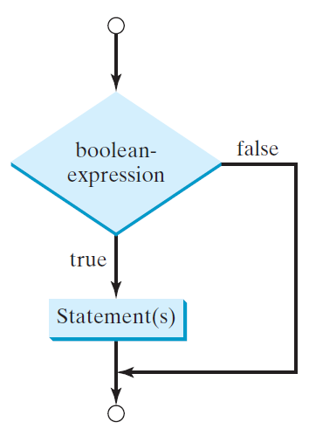
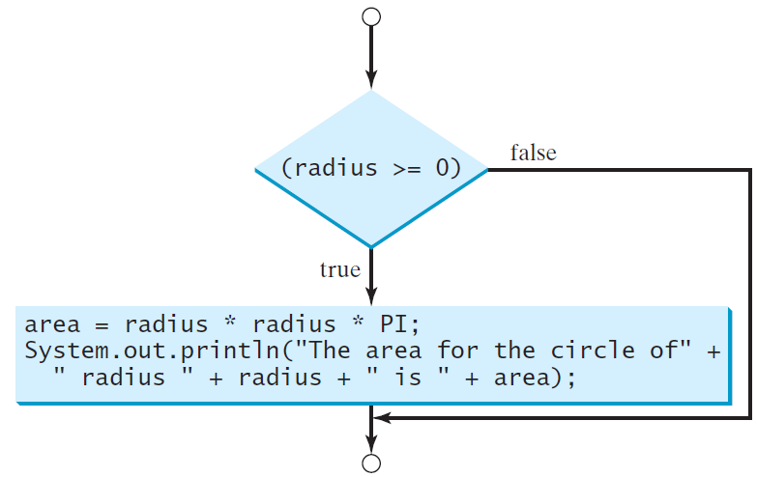
One-way if Statements
if (radius >= 0) {
area = radius * radius * PI;
System.out.println("The area"
+ " for the circle of radius "
+ radius + " is " + area);
}
if (boolean-expression) {
statement(s);
}
7

Slide 8
Note
8

Slide 9
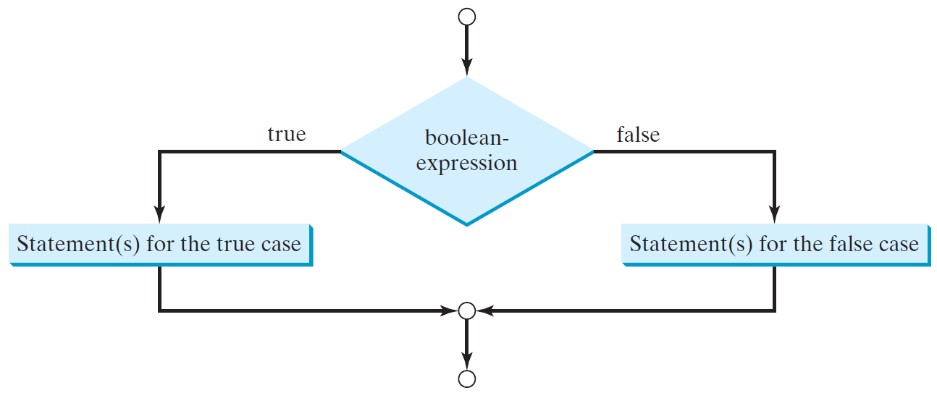
The Two-way if Statement
if (boolean-expression) {
statement(s)-for-the-true-case;
}
else {
statement(s)-for-the-false-case;
}
9

Slide 10
if-else Example
if (radius >= 0) {
area = radius * radius * 3.14159;
System.out.println("The area for the “
+ “circle of radius " + radius +
" is " + area);
}
else {
System.out.println("Negative input");
}
10

Slide 11
Multiple Alternative if Statements
11

Slide 12
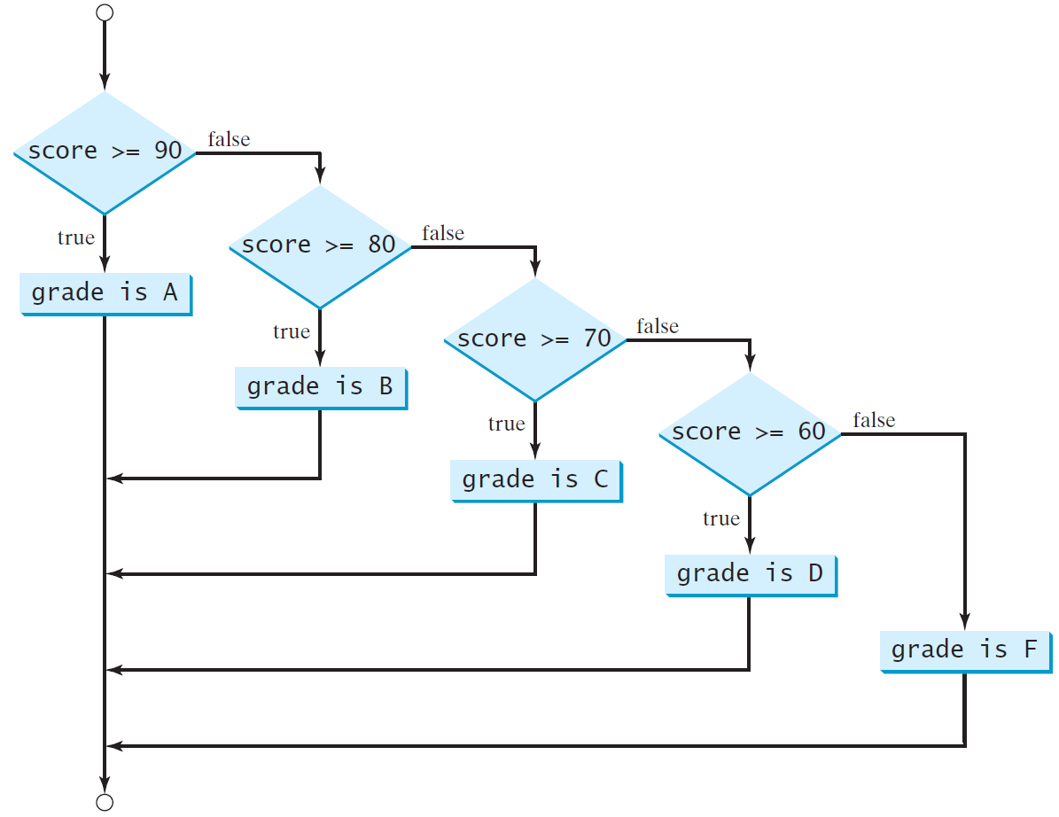
Multi-Way if-else Statements
12

Slide 13
animation
Trace if-else statement
Suppose score is 70.0
The condition is false
if (score >= 90.0)
System.out.print("A");
else if (score >= 80.0)
System.out.print("B");
else if (score >= 70.0)
System.out.print("C");
else if (score >= 60.0)
System.out.print("D");
else
System.out.print("F");
13

Slide 14
animation
Trace if-else statement
Suppose score is 70.0
The condition is false
if (score >= 90.0)
System.out.print("A");
else if (score >= 80.0)
System.out.print("B");
else if (score >= 70.0)
System.out.print("C");
else if (score >= 60.0)
System.out.print("D");
else
System.out.print("F");
14

Slide 15
animation
Trace if-else statement
Suppose score is 70.0
The condition is true
if (score >= 90.0)
System.out.print("A");
else if (score >= 80.0)
System.out.print("B");
else if (score >= 70.0)
System.out.print("C");
else if (score >= 60.0)
System.out.print("D");
else
System.out.print("F");
15

Slide 16
animation
Trace if-else statement
Suppose score is 70.0
grade is C
if (score >= 90.0)
System.out.print("A");
else if (score >= 80.0)
System.out.print("B");
else if (score >= 70.0)
System.out.print("C");
else if (score >= 60.0)
System.out.print("D");
else
System.out.print("F");
16

Slide 17
animation
Trace if-else statement
Suppose score is 70.0
Exit the if statement
if (score >= 90.0)
System.out.print("A");
else if (score >= 80.0)
System.out.print("B");
else if (score >= 70.0)
System.out.print("C");
else if (score >= 60.0)
System.out.print("D");
else
System.out.print("F");
17

Slide 18
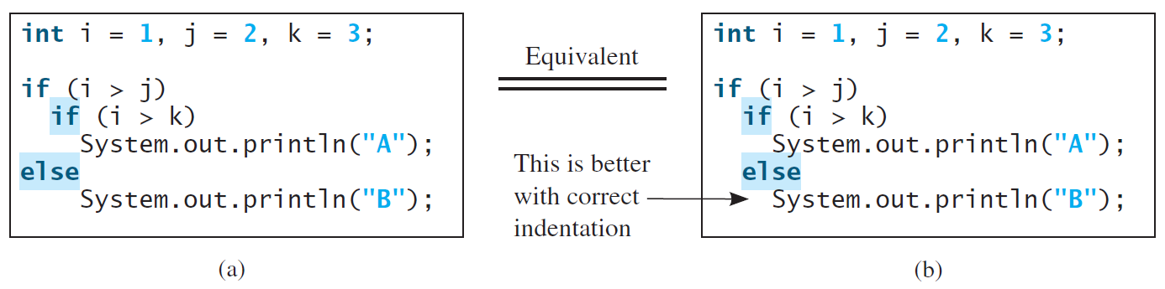
Note
The else clause matches the most recent if clause in the same block.
18

Slide 19
Note, cont.
Nothing is printed from the preceding statement. To force the else clause to match the first if clause, you must add a pair of braces:
int i = 1;
int j = 2;
int k = 3;
if (i > j) {
if (i > k)
System.out.println("A");
}
else
System.out.println("B");
This statement prints B.
19

Slide 20
Common Errors
Adding a semicolon at the end of an if clause is a common mistake.
if (radius >= 0);
{
area = radius*radius*PI;
System.out.println(
"The area for the circle of radius " +
radius + " is " + area);
}
This mistake is hard to find, because it is not a compilation error or a runtime error, it is a logic error.
This error often occurs when you use the next-line block style.
Wrong
20

Slide 21
TIP
21

Slide 22
CAUTION
22

Slide 23
Problem: Body Mass Index
Body Mass Index (BMI) is a measure of health on weight. It can be calculated by taking your weight in kilograms and dividing by the square of your height in meters. The interpretation of BMI for people 16 years or older is as follows:
ComputeAndInterpretBMI
23

Slide 24
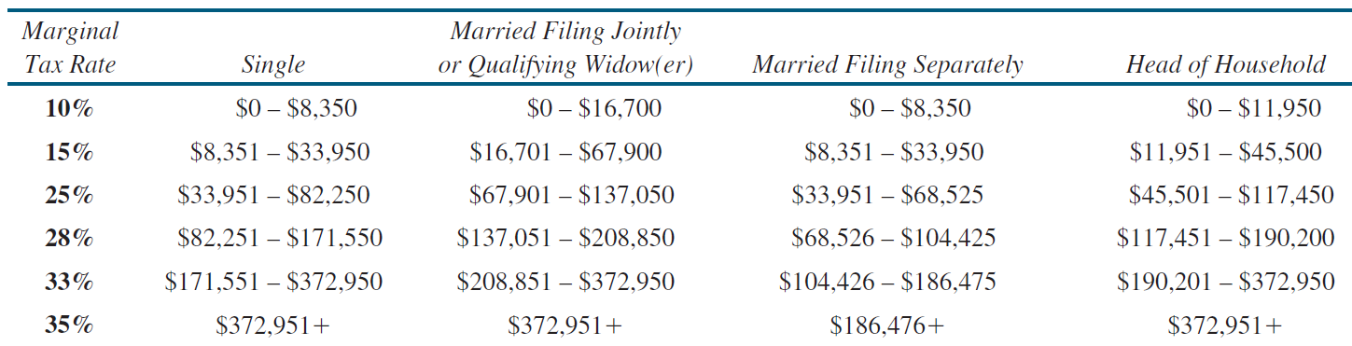
Problem: Computing Taxes
The US federal personal income tax is calculated based on the filing status and taxable income. There are four filing statuses: single filers, married filing jointly, married filing separately, and head of household. The tax rates for 2009 are shown below.
24

Slide 25
Problem: Computing Taxes, cont.
if (status == 0) {
// Compute tax for single filers
}
else if (status == 1) {
// Compute tax for married file jointly
// or qualifying widow(er)
}
else if (status == 2) {
// Compute tax for married file separately
}
else if (status == 3) {
// Compute tax for head of household
}
else {
// Display wrong status
}
ComputeTax
25

Slide 26
Logical Operators
Operator | Name | Description
! | not | logical negation
&& | and | logical conjunction
|| | or | logical disjunction
^ | exclusive or | logical exclusion
26

Slide 27
Truth Table for Operator !
p | !p | Example (assume age = 24, weight = 140)
true | false | !(age > 18) is false, because (age > 18) is true.
false | true | !(weight == 150) is true, because (weight == 150) is false.
27

Slide 28
Truth Table for Operator &&
p₁ | p₂ | p₁ && p₂ | Example (assume age = 24, weight = 140)
false | false | false | (age <= 18) && (weight < 140) is false, because (age > 18) and (weight <= 140) are both false.
false | true | false | (age <= 18) && (weight >= 140) is false, because (weight > 140) is false.
true | false | false | (age > 18) && (weight > 140) is false, because (weight > 140) is false.
true | true | true | (age > 18) && (weight >= 140) is true, because both (age > 18) and (weight >= 140) are true.
28

Slide 29
Truth Table for Operator ||
p₁ | p₂ | p₁ || p₂ | Example (assume age = 24, weight = 140)
false | false | false | (age > 34) || (weight >= 150) is false, because (age > 34) is false and (weight >= 150) is false.
false | true | true | (age > 34) || (weight <= 140) is true, because (age > 34) is false, but (weight <= 140) is true.
true | false | true | (age > 14) || (weight >= 150) is true, because (age > 14) is true.
true | true | true | (age > 14) || (weight <= 140) is true, because (age > 14) is true and (weight <= 140) is true.
29

Slide 30
Truth Table for Operator ^
p₁ | p₂ | p₁ ^ p₂ | Example (assume age = 24, weight = 140)
false | false | false | (age > 34) ^ (weight > 140) is false, because (age > 34) is false and (weight > 140) is false.
false | true | true | (age > 34) ^ (weight >= 140) is true, because (age > 34) is false but (weight >= 140) is true.
true | false | true | (age > 14) ^ (weight > 140) is true, because (age > 14) is true and (weight > 140) is false.
true | true | false | (age > 14) ^ (weight >= 140) is false, because (age > 14) is true and (weight >= 140) is true.
30

Slide 31
Examples
Here is a program that checks whether a number is divisible by 2 and 3, whether a number is divisible by 2 or 3, and whether a number is divisible by 2 or 3 but not both:
TestBooleanOperators
Run
31

Slide 32
Examples
System.out.println("Is " + number + " divisible by 2 and 3? " +
((number % 2 == 0) && (number % 3 == 0)));
System.out.println("Is " + number + " divisible by 2 or 3? " +
((number % 2 == 0) || (number % 3 == 0)));
System.out.println("Is " + number +
" divisible by 2 or 3, but not both? " +
((number % 2 == 0) ^ (number % 3 == 0)));
TestBooleanOperators
Run
32

Slide 33
Companion Website
The & and | Operators
If x is 1, what is x after this expression?
(x > 1) & (x++ < 10)
If x is 1, what is x after this expression?
(1 > x) && ( 1 > x++)
How about (1 == x) | (10 > x++)?
(1 == x) || (10 > x++)?
33

Slide 34
Problem: Determining Leap Year?
This program first prompts the user to enter a year as an int value and checks if it is a leap year.
A year is a leap year if it is divisible by 4 but not by 100, or it is divisible by 400.
(year % 4 == 0 && year % 100 != 0) || (year % 400 == 0)
LeapYear
Run
34

Slide 35
Problem: Lottery
Write a program that randomly generates a lottery of a two-digit number, prompts the user to enter a two-digit number, and determines whether the user wins according to the following rule:
If the user input matches the lottery in exact order, the award is $10,000.
If the user input matches the lottery, the award is $3,000.
If one digit in the user input matches a digit in the lottery, the award is $1,000.
Lottery
35

Slide 36
switch Statements
switch (status) {
case 0: compute taxes for single filers;
break;
case 1: compute taxes for married file jointly;
break;
case 2: compute taxes for married file separately;
break;
case 3: compute taxes for head of household;
break;
default: System.out.println("Errors: invalid status");
System.exit(1);
}
36

Slide 37
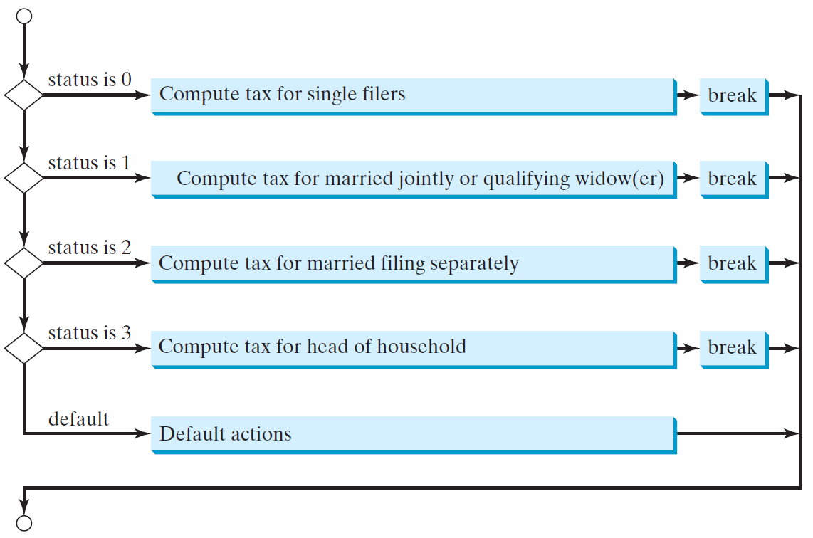
switch Statement Flow Chart
37

Slide 38
switch Statement Rules
The switch-expression must yield a value of char, byte, short, or int type and must always be enclosed in parentheses.
switch (switch-expression) {
case value1: statement(s)1;
break;
case value2: statement(s)2;
break;
…
case valueN: statement(s)N;
break;
default: statement(s)-for-default;
}
The value1, ..., and valueN must have the same data type as the value of the switch-expression. The resulting statements in the case statement are executed when the value in the case statement matches the value of the switch-expression. Note that value1, ..., and valueN are constant expressions, meaning that they cannot contain variables in the expression, such as 1 + x.
38

Slide 39
switch Statement Rules
The keyword break is optional, but it should be used at the end of each case in order to terminate the remainder of the switch statement. If the break statement is not present, the next case statement will be executed.
switch (switch-expression) {
case value1: statement(s)1;
break;
case value2: statement(s)2;
break;
…
case valueN: statement(s)N;
break;
default: statement(s)-for-default;
}
The default case, which is optional, can be used to perform actions when none of the specified cases matches the switch-expression.
When the value in a case statement matches the value of the switch-expression, the statements starting from this case are executed until either a break statement or the end of the switch statement is reached.
39

Slide 40
animation
Trace switch statement
Suppose day is 2:
switch (day) {
case 1:
case 2:
case 3:
case 4:
case 5: System.out.println("Weekday"); break;
case 0:
case 6: System.out.println("Weekend");
}
40

Slide 41
animation
Trace switch statement
Match case 2
switch (day) {
case 1:
case 2:
case 3:
case 4:
case 5: System.out.println("Weekday"); break;
case 0:
case 6: System.out.println("Weekend");
}
41

Slide 42
animation
Trace switch statement
Fall through case 3
switch (day) {
case 1:
case 2:
case 3:
case 4:
case 5: System.out.println("Weekday"); break;
case 0:
case 6: System.out.println("Weekend");
}
42

Slide 43
animation
Trace switch statement
Fall through case 4
switch (day) {
case 1:
case 2:
case 3:
case 4:
case 5: System.out.println("Weekday"); break;
case 0:
case 6: System.out.println("Weekend");
}
43

Slide 44
animation
Trace switch statement
Fall through case 5
switch (day) {
case 1:
case 2:
case 3:
case 4:
case 5: System.out.println("Weekday"); break;
case 0:
case 6: System.out.println("Weekend");
}
44

Slide 45
animation
Trace switch statement
Encounter break
switch (day) {
case 1:
case 2:
case 3:
case 4:
case 5: System.out.println("Weekday"); break;
case 0:
case 6: System.out.println("Weekend");
}
45

Slide 46
animation
Trace switch statement
Exit the statement
switch (day) {
case 1:
case 2:
case 3:
case 4:
case 5: System.out.println("Weekday"); break;
case 0:
case 6: System.out.println("Weekend");
}
46

Slide 47
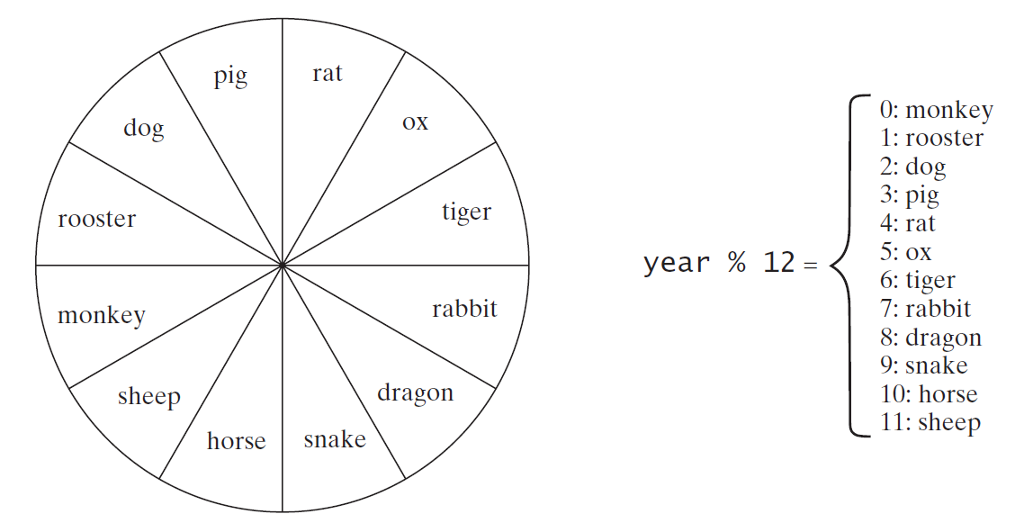
Problem: Chinese Zodiac
Write a program that prompts the user to enter a year and displays the animal for the year.
ChineseZodiac
47

Slide 48
Conditional Expressions
if (x > 0)
y = 1
else
y = -1;
is equivalent to
y = (x > 0) ? 1 : -1;
(boolean-expression) ? expression1 : expression2
Ternary operator
Binary operator
Unary operator
48

Slide 49
Conditional Operator
if (num % 2 == 0)
System.out.println(num + “is even”);
else
System.out.println(num + “is odd”);
System.out.println(
(num % 2 == 0)? num + “is even” :
num + “is odd”);
49

Slide 50
Conditional Operator, cont.
boolean-expression ? exp1 : exp2
50

Slide 51
Operator Precedence
var++, var--
+, - (Unary plus and minus), ++var,--var
(type) Casting
! (Not)
*, /, % (Multiplication, division, and remainder)
+, - (Binary addition and subtraction)
<, <=, >, >= (Relational operators)
==, !=; (Equality)
^ (Exclusive OR)
&& (Conditional AND) Short-circuit AND
|| (Conditional OR) Short-circuit OR
=, +=, -=, *=, /=, %= (Assignment operator)
51

Slide 52
Operator Precedence and Associativity
The expression in the parentheses is evaluated first. (Parentheses can be nested, in which case the expression in the inner parentheses is executed first.) When evaluating an expression without parentheses, the operators are applied according to the precedence rule and the associativity rule.
If operators with the same precedence are next to each other, their associativity determines the order of evaluation. All binary operators except assignment operators are left-associative.
52

Slide 53
Operator Associativity
When two operators with the same precedence are evaluated, the associativity of the operators determines the order of evaluation. All binary operators except assignment operators are left-associative.
a – b + c – d is equivalent to ((a – b) + c) – d
Assignment operators are right-associative. Therefore, the expression
a = b += c = 5 is equivalent to a = (b += (c = 5))
53

Slide 54
Example
Applying the operator precedence and associativity rule, the expression 3 + 4 * 4 > 5 * (4 + 3) - 1 is evaluated as follows:
54

Slide 55
Operand Evaluation Order
Companion Website
Supplement III.A, “Advanced discussions on how an expression is evaluated in the JVM.”
55

Slide 56
Debugging
Logic errors are called bugs. The process of finding and correcting errors is called debugging. A common approach to debugging is to use a combination of methods to narrow down to the part of the program where the bug is located. You can hand-trace the program (i.e., catch errors by reading the program), or you can insert print statements in order to show the values of the variables or the execution flow of the program. This approach might work for a short, simple program. But for a large, complex program, the most effective approach for debugging is to use a debugger utility.
56

Slide 57
Debugger
Debugger is a program that facilitates debugging. You can use a debugger to
Execute a single statement at a time.
Trace into or stepping over a method.
Set breakpoints.
Display variables.
Display call stack.
Modify variables.
57

